Slide 1
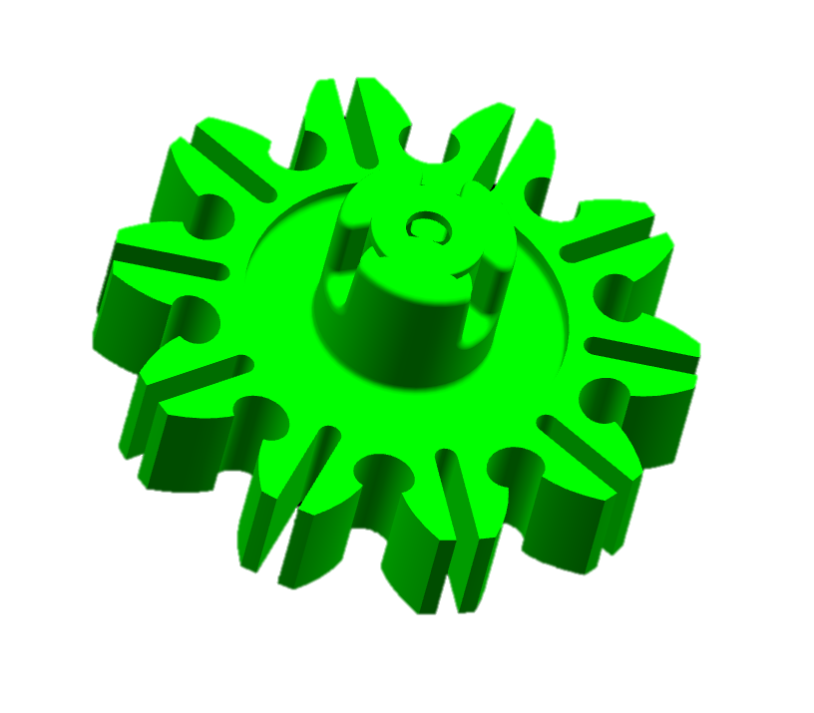

CCM-174: Zero-Lash Spur Gear
Last updated: 23FEB16
Description
Transmits absolute position of worm gear
Compensates for large tolerance stack up by using increased mesh interferences
Motivation:
Deliverables
Finalized Design
Prototypes for Validation
Timing
Finalized Design – 01JUN16
VSS 9BUX SOP – 01JAN18
Team Members/Customers
Team names: Adam Lee/Jeff Beyerlein
Customers: Sensor Group/Applications

Slide 2
CCM-174: Zero-Lash Spur Gear
Last updated: 23FEB16
Status Update:
Initial Design Proposed – 01SEP15
Prototype Parts Made – 15OCT15
Prototype Testing Started – 18JAN16
1 life of Durability at 125 C – Pass
Maintains Accuracy at 125 C – Pass
1 life of Durability at -40 C – Ongoing
Maintains Accuracy at -40 C – Ongoing
Design w/ Prod. Features –
Parts Made –
Challenges:
Quieter than current design, but still has running noise
Molding process that is robust to plastic deformation of small teeth
If design will take up the entire tolerance without preload feature
Next Actions:
Finish Temperature Testing
Propose a new design incorporating production level features
Cost impact analysis

